Slide 1


Project: Vehicle Insurance Fraud Detection and Analysis Using Machine Learning
Name :- Shubham Santosh Jadhav
Batch :- Data science June 2025

Slide 2


Content
Subject Information
Problem Statement
Dataset Details
Data Cleaning and Feature Engineering
Machine Learning Algorithms
Conclusion
Image

Slide 3
Subject INFORMATION
INFO
What is your subject?
Subject Information :-
Data Science / Machine Learning
Topic:
Vehicle Insurance Fraud Detection using Data Science
Subject Description:
This subject focuses on applying data science and machine learning techniques to solve real-world problems. In this project, we analyze vehicle insurance claim data to identify fraudulent claims. The project includes data preprocessing, exploratory data analysis (EDA), model building, and evaluation using different machine learning algorithms

Slide 4
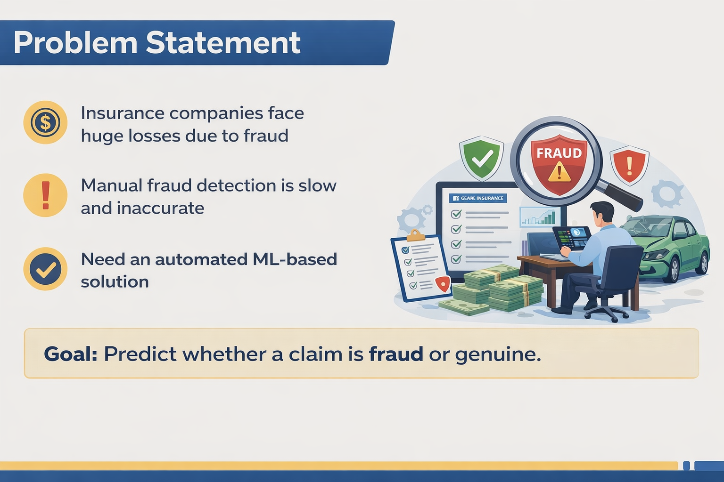
Problem statement
Add Problem Statement/Objective
Content:
Insurance companies face huge losses due to fraud
Manual fraud detection is slow and inaccurate
Need an automated ML-based solution
Explain:
Goal is to predict whether a claim is fraud or genuine.

Slide 5
dataset
Dataset Head
Month | WeekOfMonth | DayOfWeek | Make | AccidentArea | DayOfWeekClaimed | MonthClaimed | WeekOfMonthClaimed | Sex | MaritalStatus | ... | AgeOfVehicle | AgeOfPolicyHolder | PoliceReportFiled | WitnessPresent | AgentType | NumberOfSuppliments | AddressChange_Claim | NumberOfCars | Year | BasePolicy
0 | Dec | 5 | Wednesday | Honda | Urban | Tuesday | Jan | 1 | Female | Single | ... | 3 years | 26 to 30 | No | No | External | none | 1 year | 3 to 4 | 1994 | Liability
1 | Jan | 3 | Wednesday | Honda | Urban | Monday | Jan | 4 | Male | Single | ... | 6 years | 31 to 35 | Yes | No | External | none | no change | 1 vehicle | 1994 | Collision
2 | Oct | 5 | Friday | Honda | Urban | Thursday | Nov | 2 | Male | Married | ... | 7 years | 41 to 50 | No | No | External | none | no change | 1 vehicle | 1994 | Collision
3 | Jun | 2 | Saturday | Toyota | Rural | Friday | Jul | 1 | Male | Married | ... | more than 7 | 51 to 65 | Yes | No | External | more than 5 | no change | 1 vehicle | 1994 | Liability
4 | Jan | 5 | Monday | Honda | Urban | Tuesday | Feb | 2 | Female | Single | ... | 5 years | 31 to 35 | No | No | External | none | no change | 1 vehicle | 1994 | Collision
15420 rows × 33 columns

Slide 6
Dataset Cleaning
Methods Used & Why?
Checking Correlation using heatmap
1. Logistic Regression
Why used?
Simple and fast classification algorithm Works well for binary outcomes (Fraud / Genuine)Easy to interpret results
2. Decision Tree
Why used?
Handles non-linear relationships Easy to visualize and explainIdentifies important features affecting fraud
3. Random Forest
Why used?
Ensemble method (multiple decision trees) High accuracy and better fraud detection Reduces overfitting compared to a single tree
4. Model Evaluation Metrics
Why used?
Accuracy: Overall performance Confusion Matrix: Fraud vs Genuine prediction Classification Report: Precision, Recall, F1-Score
Correlation shows how strongly two variables are related to each other.
Values range from -1 to +1
+1 → strong positive relation
-1 → strong negative relation
0 → no relation
Why Use a Heatmap?
Visualizes correlation in an easy color format
Helps identify important features
Detects multicollinearity (highly related features)
Improves feature selection for ML models

Slide 7
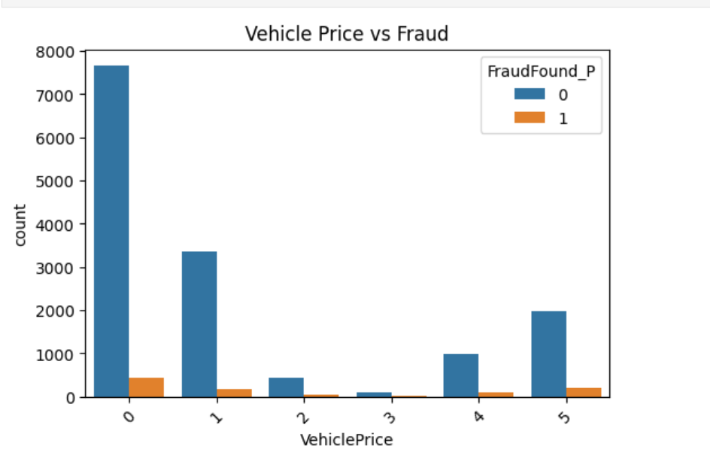
EDA
Charts: Countplot()

Slide 8
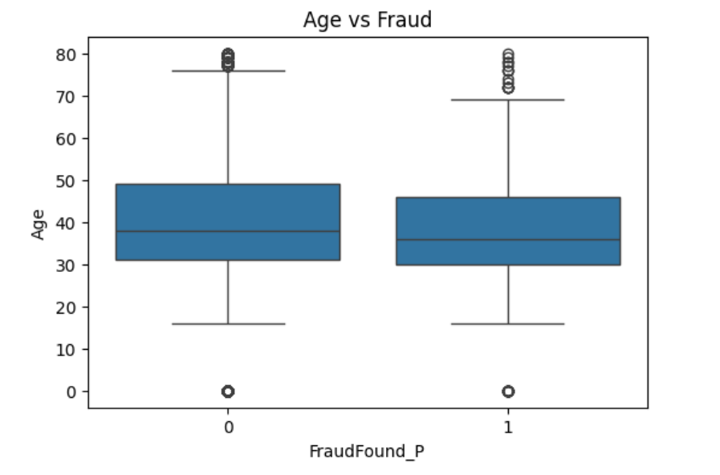
EDA
Charts: boxplot()

Slide 9
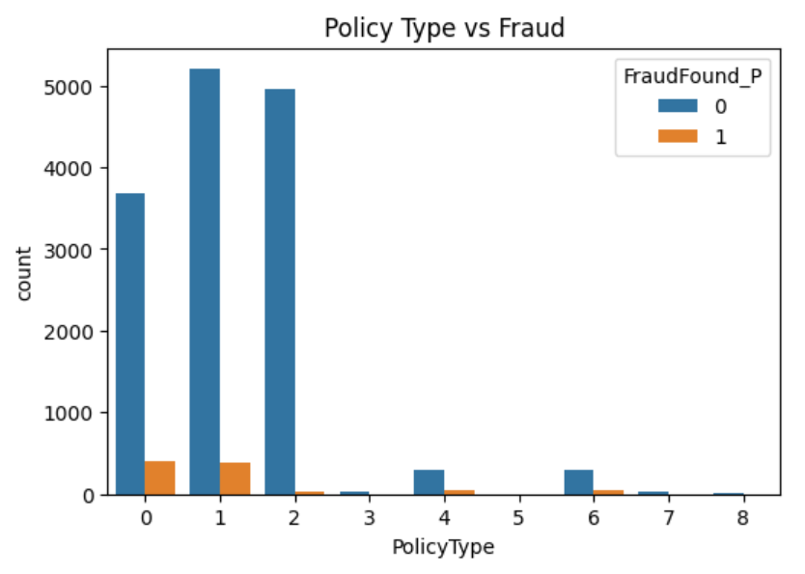
EDA
Charts: countplot()

Slide 10
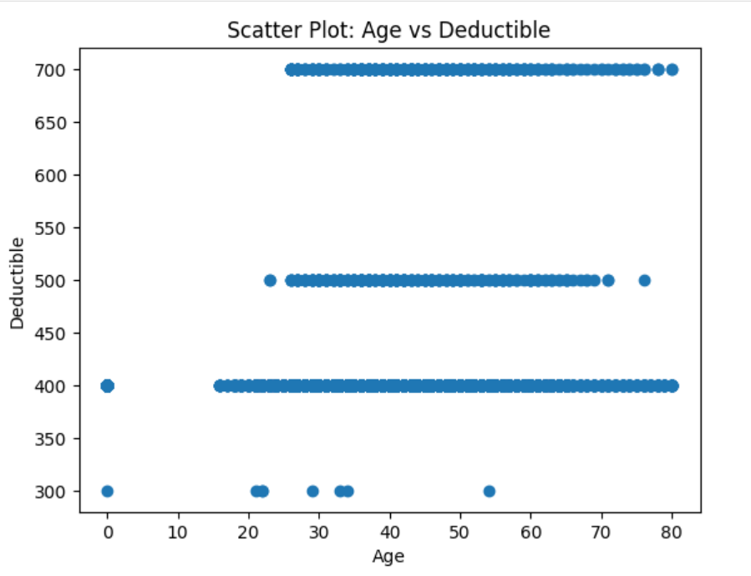
EDA
Charts: Scatterplots()

Slide 11
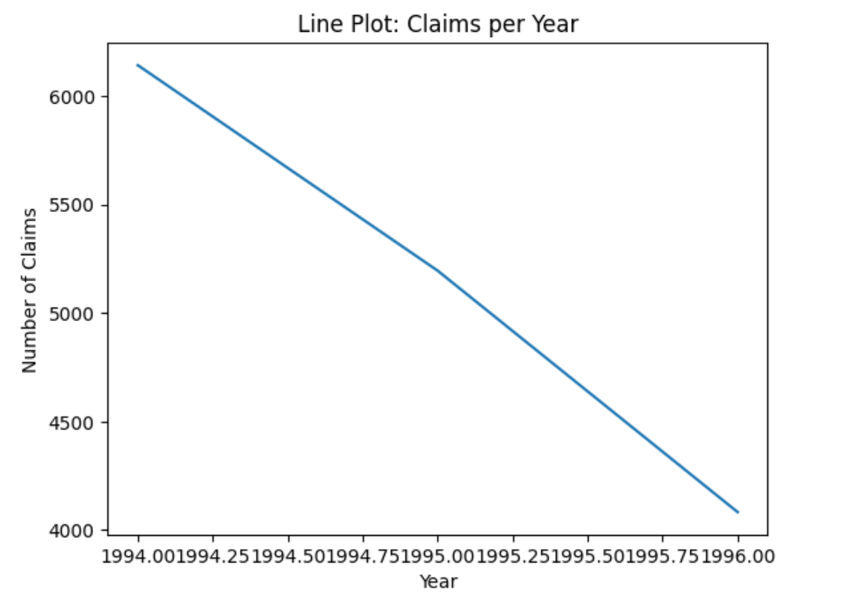
EDA
Charts: Lineplots()

Slide 12
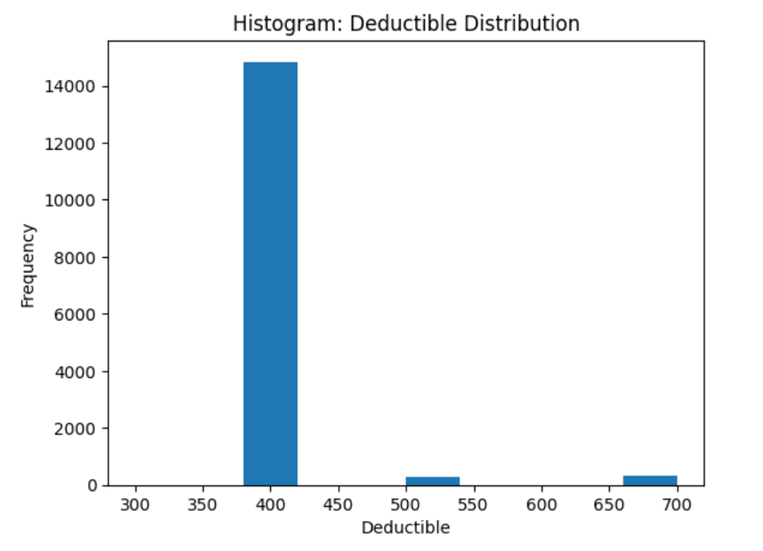
EDA
Charts: Histogram()

Slide 13
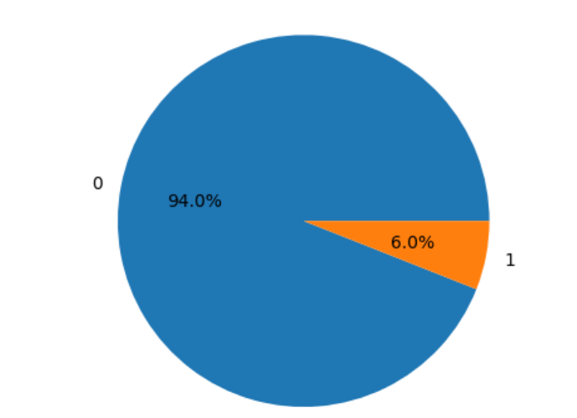
EDA
Charts: Piechart()

Slide 14
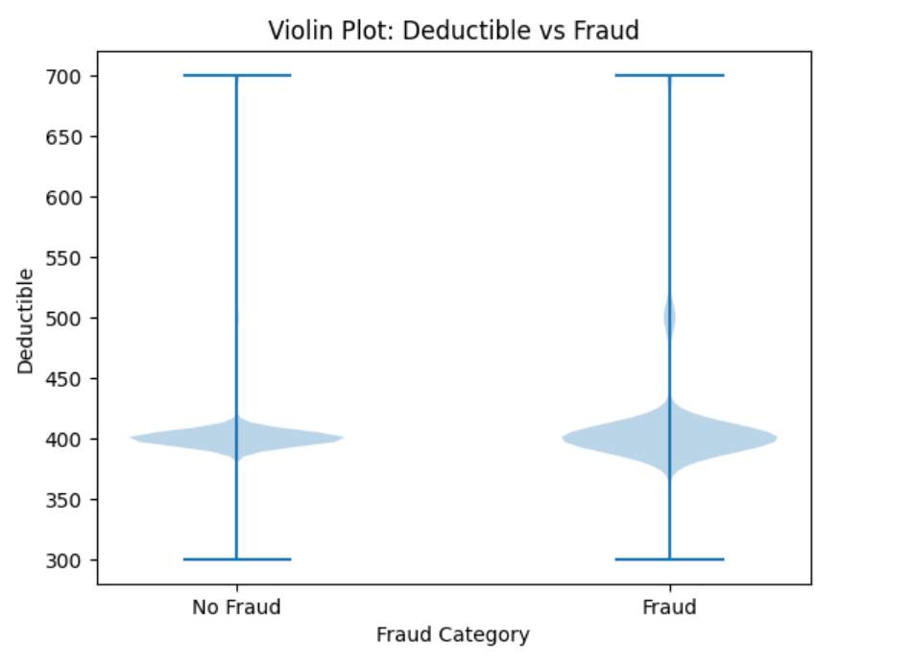
EDA
Charts: Violin Plot()

Slide 15
Feature engineering
Encoding & Scaling used?, Which Method? Why?
Why Encoding?
Machine Learning models cannot understand text data
Categorical values like Male/Female, Yes/No, Type_A/Type_B must be converted into numbers
Why Scaling?
Features have different ranges
  Claim Amount → 1,000 to 10,00,000
  Age → 18 to 80
Distance-based algorithms get biased toward large values
Data separated into Train-Test sets for Predictive Analysis
X_train, X_test, y_train, y_test = train_test_split(X, y,test_size=0.25,random_state=42,stratify=y)
Now Its time for Machine Learning Model Building

Slide 16
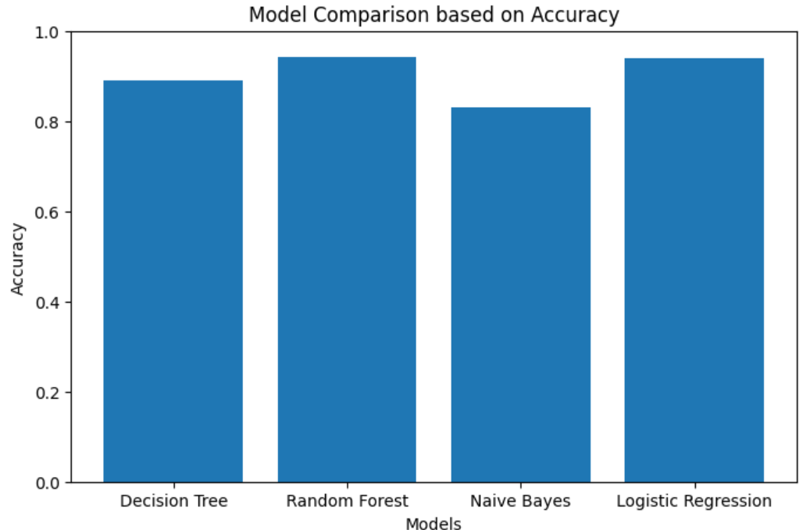
Machine learning models with algorithm
Following Classification Algorithm Used for Machine Learning Model Building
1. Decision Tree
2. Random Forest
3. Naive Bayes
4. Logistic Regression
Model Evaluation | Alg-1 | Alg-2 | Alg-3 | Alg-4
Accuracy Score | 0.89 | 0.94 | 0.83 | 0.94
Recall | 0.93 0.23 | 1.00 0.03 | 0.86 0.41 | 1.00 0.00
Precision | 0.95 0.17 | 0.94 0.86 | 0.96 0.16 | 0.94 0.00
F-1 Score | 0.94 0.94 | 0.97 0.05 | 0.90 0.23 | 0.97 0.00
Confusion Matrix | [[3378 246] [ 179 52]] | [[3623 1] [ 225 6]] | [[3107 517] [ 136 95]] | [[3624 0] [ 231 0]]
Column Graph

Slide 17
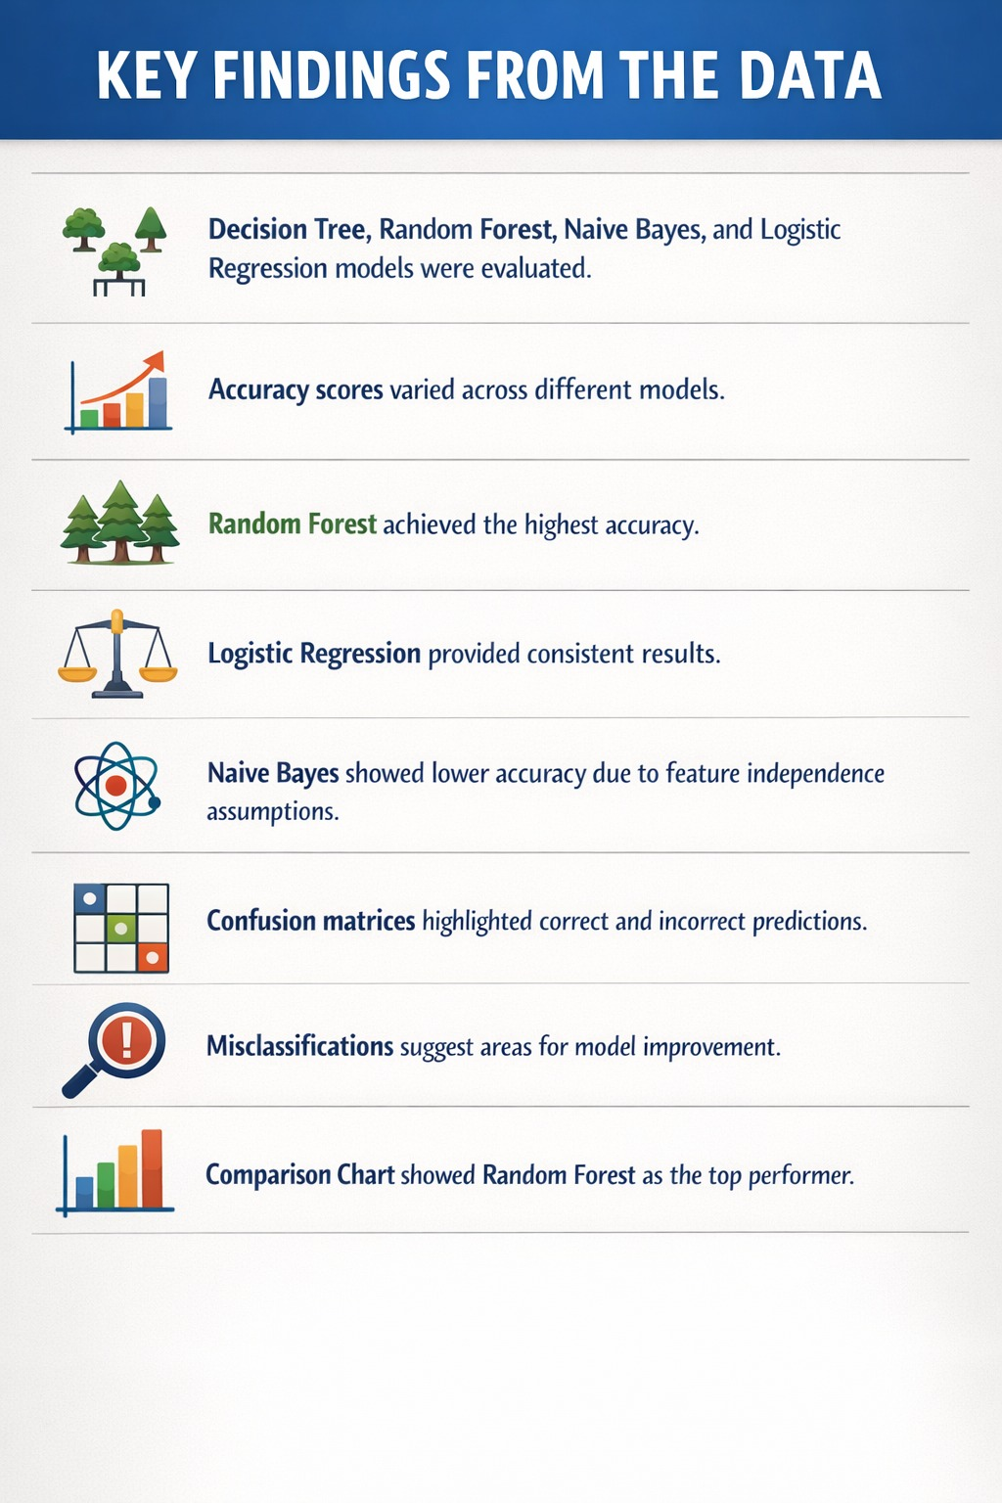
conclusion
Add conclusion….
Best Model :- Random Forest 0.94 , 3855
Key findings from data :- “The key finding is that ensemble models like Random Forest achieve higher accuracy, while simpler models like Logistic Regression and Naive Bayes provide interpretable and baseline results. Visual tools such as confusion matrices and column graphs help in understanding model performance clearly.”

Slide 18

Thank you

